Slide 1
Subtopic N3.7 - Short Division (without carrying)
LEARNING OUTCOME: To understand how to apply short division to solve problems.
Keywords:
Divide
Share
Dividend
Divisor
Objectives:
To use short division where carrying is not required.
To use short division to solve problems in context.
Introduction – read and annotate:
In this subtopic, you'll focus on short division problems that don’t involve carrying or remainders, so
you can clearly understand the steps of the method. Mastering this will give you a strong foundation
for tackling more difficult division later on.
Definition
Characteristics
Splitting a number into equal parts.​
Involves two numbers: dividend and divisor.
The result of division is called the quotient.
Division can result in a whole number, a fraction, or a decimal, depending on the numbers involved.
Division is denoted by the symbol "÷" or the fraction bar "⁄"
Examples
Division
Non - Examples
10 ÷ 2 = 5
8 ÷ 4 = 2
21 ÷ 7 = 3
1.5 ÷ 0.5 = 3
Addition and subtraction are not division operations.
Multiplication is the inverse of division but is a different operation.
Ratios and proportions are related concepts but are not division.
Short division – without carrying
Example 1 – I do…
Example 2 – We do…
Example 3 – You do…
Steps
1) Lay out the short division, making sure the divisor is on the outside. 2) Starting from the left, divide into each digit.
312
201
213

Slide 2
Example 4 – I do…
Example 5 – We do…
Example 6 – You do…
Steps
Lay out the short division, making sure the divisor is on the outside.
Starting from the left, divide into each digit.
3123
2012
2013
Independent Practice
Question 1
321
312
132
302
112
220
100
1023
1003
2222
1201
1000
1010
1001
1010

Slide 3
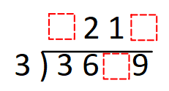
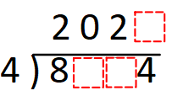
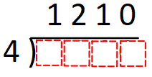

Independent Practice
Question 1 continued
Question 2
For the following questions, fill in the missing blanks.
a) | b) | c)
d) | e) | f)
g) | h) | i)
2002
3003
3333
1111
2222
11232
23123
12122
10212
10012
21210
201201
1 3
1
3
0 8
4 8 4 0
2 3
2 1
2 1
3 0 1 2
2 0
3 6 9
6 3
3
9 0 3 6
8 4
4 8 0
1 0 1 0
1 0
2 1 0 1 1
1 0
7
7 0 7 0
8 8 0
8 0
3 6 0 6
6

Slide 4
Question 3 | Question 4 | Question 5
A toy costs £6. Over a week, a shop makes £660 from selling the toy. How many toys were sold? | A group of 3 friends take a journey in a taxi. The total cost of the journey is £96. The friends share the cost equally. How much does each person pay? | A journey lasts 707 days. How many weeks is this?
Question 6 | Question 7 | Question 8
A school has 4 year groups and 884 students in total. Each year group has an equal number of students. How many students are in each year group? | Miss Jenkins has 26 bags of sweets. Each bag contains 34 sweets. Miss Jenkins shares as many sweets as possible equally among her 4 classes. How many sweets do each class get? | James hired a holiday cottage for 7 days for £840. Ben hires the same cottage, at the same price per day, for 4 days. How much will this cost Ben?
110
£23
101
221
221
£440

Slide 5
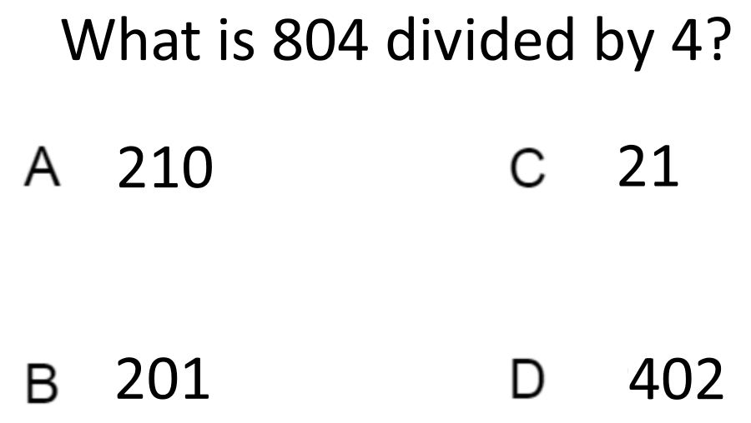

Skills Check
What number goes in the box?
A. 3 B. 1 C. 0 D. 9
2 3 2 0
3 6 9 6

